Slide 1
Community Health Center Stakeholder Breakout Session Tuesday, February 11, 2020 4:30 – 5:45 PM Moderator: Colleen Meiman Senior Policy Advisor National Association of Community Health Centers

Slide 2
Where to Find THESE Slides
On Noddlepod
We’ll explain what that is if you don’t know.
OR
On the NACHC 340B website
Google “NACHC 340B”

Slide 3
Panelists:
Michael Glomb
Partner, Feldesman Tucker Leifer Fidell, LLC
mglomb@feldesmantucker.com
Chad Johnson, PharmD, MBA
Manager, 340B Education and Compliance Support, Apexus
chad.johnson@Apexus.com
Sue Veer
CEO, Carolina Health Centers
sveer@carolinahealthcenters.org

Slide 4
Statement of Conflicts of Interest
Colleen Meiman has no actual or potential conflict of interest in relation to this presentation.
Michael Glomb has no actual or potential conflict of interest in relation to this presentation.
Chad Johnson has no actual or potential conflict of interest in relation to this presentation.
Sue Veer Chad Johnson has no actual or potential conflict of interest in relation to this presentation.

Slide 5
Today’s Goals
Share FQHC-specific resources on 340B
Provide an overview of recent 340B recent developments, from the FQHC perspective.
Address the issues raised most frequently in the survey, and direct you to resources with more information.

Slide 6
340B Resources specifically for Health Centers

Slide 7
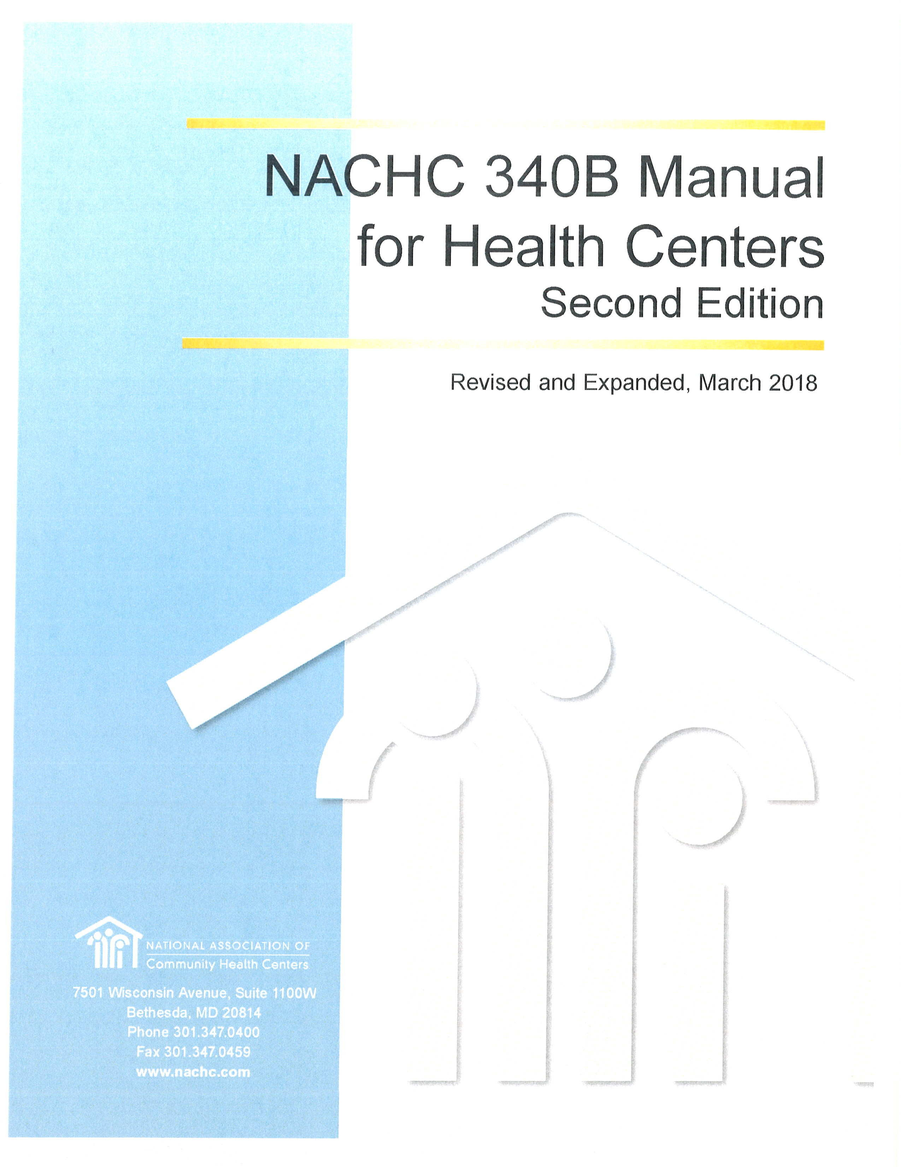
Resources available to the Health Center 340B RX Community
NACHC 340B Compliance Manual
Noddlepod, Noddlepod, Noddlepod
340B Office Hours
340B Coalition bi-annual conferences with CHC specific programming
Apexus
Apexus Answers
340B Tools - https://www.340bpvp.com/education/340b-tools/
Health center specific 340B University at CHI and P&I
CEO and CFO Institute modules
Training resources including programs tailored to the needs of states and individual health centers
1-1 technical assistance

Slide 8
FQHC-SPECIFIC Resources ON 340B
Resource | Best For: | How to Access:
NACHC 340B Manual | Consolidated source of info on wide range of topics | Google “NACHC 340B Manual”
Office Hours – free webinar on third Thursday of the month, 2 PM ET | Operational updates; Q&A. (No advocacy.) Focus is on all pharmacy issues. | See NACHC and BPHC emails; also Colleen’s email signature
Noddlepod –web-based discussion platform limited to FQHCs | Group discussions; peer input; can discuss advocacy | tmallett@340basics.com
Technical Assistance from an operational expert (Tim Mallett) -- under contract with NACHC | Pharmacy operations, 340B, and policy questions
340B University focused on FQHCs | Free, full-day, in-person overview of 340B, focused on FQHCs. Planned by Apexus, led by FQHCs. | Sun. 3/15/20 in Washington DC; also in August in San Diego (before NACHC CHI)
Apexus | Technical, operational, and policy questions | 888.340.BPVP (2787)

Slide 9
340B University – JUST for FQHCs
Sunday March 15, 2020
Washington DC (same hotel as NACHC P&I)
Specifically for FQHCs – and taught by FQHCs
FREE – but pre-registration is required – go to https://www.340bpvp.com/education/340b-university/ or Google “340B University.)

Slide 10
Right Here, Right Now
Q&A/ Networking Breakfast for FQHCs
Tomorrow (Wed) at 7:15 – 8:30
Sapphire Boardroom.
BYOBreakfast from the Exhibit Hall
Many of your best resources are right here in this room – your FQHC colleagues.

Slide 11
Recent 340B Developments Impacting FQHCs

Slide 12
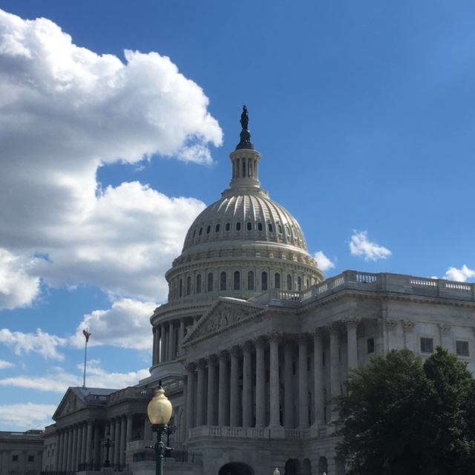
Let’s Start on the Hill
Congressional Oversight:
After the whirlwind of 2018, 340B is viewed as “a hornet’s nest made out of hornet’s nests”
Intensity may have decreased but the threat remains present
Focus has shifted to drug pricing with potential for collateral damage: 209 bills match the search criteria of “drug pricing bills” in govtrack
Lingering questions about 340B:
Purpose of the program
Regulatory authority
Use of savings
Medicaid rebates vs 340B discounts

Slide 13
In the Regulatory Arena…
HRSA:
Audit activity “reboot”
Increased oversight of contract pharmacy arrangements
Clarity re: sliding fee discounts
Clarity that contract pharmacies go in Column 2
CMS
Purpose and philosophy – strengthen and serve state Medicaid programs
CMS Bulletin: Best Practices for Avoiding 340B Duplicate Discounts in Medicaid

Slide 14
Have You Recertified???
Every year, health centers must to “recertify” their 340B participation.
Recertifying entails attesting to the accuracy of your info on OPAIS, and your compliance with all 340B rules.
The deadline for 2020 recertification is February 24.
Health centers that miss the deadline are kicked out of 340B for at least three months!
See Chapter 6 of the Manual

Slide 15
Growing challenges with reimbursement…
Some challenges are impacting pharmacies everywhere:
DIR fees
Growing power or PBMs
Specialty drugs
And some are specific to FQHCs – namely, shrinking 340B savings caused by discriminatory reimbursement and disparate treatment
These financial concerns were cited as the biggest challenge to health center pharmacy programs.

Slide 16
A Short Look at Your Biggest Questions

Slide 17
Thank you to everyone who completed our survey!!!
Biggest challenge = 76 responses
Need for clarity = 66 responses
Questions = 50 responses
Your input was enormously helpful in planning this session, and future educational activities.

Slide 18
Here are the most common areas where you have expressed have challenges, questions, and concerns
Discriminatory contracting – i.e. disparate treatment of 340B covered entities
Eligibility across the continuum of care – i.e. prescriptions written outside of the health center
Establishing charges – i.e. sliding fee and cash pricing > 200 FPL
Clinic Administered Drugs and Devices – i.e. tracking and auditing, inventory management, impact on billing
Contract Pharmacy Oversight
Audits – i.e. HRSA and self audits (Integrity Plan)
C-Suite – i.e. getting their attention and Bringing Pharmacy Into the Fold
HRSA/BPHC expectations – i.e. Form 5A, sliding fee, etc.

Slide 19
Charges/Sliding Fee Scale
CHC Expert Session # 1
Engaging the C-Suite
CHC Expert Session # 2
Contract RX Oversight
Operational – i.e. CAD, referral Rx
CHC Expert Session # 3
Integrity Plan – i.e. audits and self audits

Slide 20
Resources for Engaging Your C-Suite
Chapter 2 of the NACHC 340B Manual is “The Minimum the C-Suite Needs to Understand and Do re: 340B”
340B University at NACHC P&I – Sun March 15, 2020 in DC
340B Overview Session at NACHC P&I
Education on why 340B is so much more important and complex than it used to be.

Slide 21
What a difference a decade makes!
Over the past ten years, the 340B program has expanded dramatically in size, complexity, potential, and risk.
2020
2010

Slide 22
Since February 2010
The ACA extended Medicaid rebates to managed care drugs. (Previously, Medicaid rebates were only on FFS drugs.)
The ACA made more types of providers eligible for 340B.
HRSA permitted providers to have multiple contract pharmacies.
HRSA began auditing 340B providers.
More -- and more expensive -- drugs entered the market.
The role of Rx in primary care has expanded significantly.

Slide 23
So in February 2020…
Every C-Suite member should ask:
“How important is 340B to our patients and organization?”
and then
“Does our focus on compliance and operations reflect this importance?”
340B is now a much larger, more important, and more visible program than it was 10 years ago.
No other government program is simultaneously so:
High benefit to patients
Complex and constantly evolving
Precarious

Slide 24
Discriminatory Contracting
Resources:
NACHC toolkit for state legislation – email kfriedman@nachc.org
Contains draft bill language, talking points, etc.
Your health center’s one-pager describing the importance of 340B savings to your patients and operations!
Chapter 3 of the NACHC 340B Manual

Slide 25
Lots of Variations on the Theme…
“Discriminatory contracting” refers to circumstances when a pharmacy is reimbursed less and/or subject to unique terms solely because it participates in 340B. Examples:
Reduced reimbursement
Exclusion from networks
Higher fees and/or portion of savings retained
Excluding drugs as “specialty drugs” that must be filled through a specialty pharmacy network
Lower co-pays at “captive” pharmacies
Prohibiting common services like mail-order
Additional/increased performance requirements

Slide 26
Public vs. Private Payers
Privately-Insured Patients:
Third-party insurers
Pharmacy Benefits Managers (PBMs)
TPAs*
Contract Pharmacies*
Groups that offer to help manage our 340B programs*
In Medicaid:
CMS
Requires states to take the 340B savings under FFS, encourages them to do so under managed care
State Medicaid agencies
A growing number are taking the savings under Medicaid managed care organizations (MCOs)
* In all of these cases, it is appropriate for the group to charge a fee for their 340B-related services; however, concerns arise when the fee exceeds the fair market value of the service provided.

Slide 27
What can we do about it?
National:
Statutory fix (very long shot)
Educate policymakers about trends & impacts
Monitor for threats & opportunities
Partnerships
State level:
Medicaid – educate policymakers about funding leaving the state*
Anti-discrimination legislation**
Partnerships
Operational:
Open-door RX
PSAO
Demonstrate what services would be lost
Ideas?
* See next slides. **Email kfriedman@nachc.org for the state legislation toolkit.

Slide 28
Where do Medicaid savings go?
Why the majority of “state savings” on Medicaid 340B drugs accrue to the Federal government
Medicaid costs are split between the Federal government and the states.
The exact split varies, based on the state, the service, and the patient.
The Feds pay at least 50% - & as much as 90% - of total Medicaid costs.
So 50 to 90% of Medicaid savings accrue to the Feds, rather than states.

Slide 29
Federal/ State Split of Medicaid Rx Savings
Assume: Ms. Jones, a Medicaid managed care patient, gets a Rx at a FQHC.
The drug’s regular price is $40.
The 340B discount and the Medicaid rebate are both $10.
So the net price under both 340B and Medicaid is $30.
OPTION ONE:
The FQHC buys the drug under 340B ($30)
Medicaid reimburses the FQHC the regular price ($40)
The FQHC retains $10 in savings.
OPTION TWO
The FQHC buys the drug under 340B ($30)
Medicaid reimburses the FQHC the 340B price ($30)
“The state saves $10.”
OPTION THREE
The FQHC buys the drug at regular price ($40)
Medicaid reimburses the FQHC the regular price ($40)
The state applies for the rebate ($10)
“The state saves $10.”
But that’s not the end of the story!

Slide 30
Examples
When “the state gets the $10 savings”, only a fraction of those dollars stay in the state. For example:
Ms. Jones is a “traditional” Medicaid enrollee in a state like AK, CA, or VA, where the Feds pay 50% of costs for traditional enrollees:
Of her state’s $10 in Rx savings, $5 goes back to the Feds – so the state retains $5 in net savings.
Ms. Jones is a “traditional” Medicaid enrollee in a state like WV or MS, where the Feds pay around 75% of costs for traditional enrollees:
Of her state’s $10 in Rx savings, $7.50 goes back to the Feds – so the state retains $2.50 in net savings.
Ms. Jones is a Medicaid expansion enrollee, so the Feds pay 90% of her costs:
Of her state’s $10 in Rx savings, $9 goes back to the Feds – so the state retains $1 in net savings.
When the FQHC gets the $10 savings, the full $10 stays in the state and is invested in activities that expand access for underserved populations.

Slide 31
HOW do the Feds get the savings?
Technically, when a state keeps the drug savings, it doesn’t “send back” the Feds’ share in the form of a check or refund.
Rather, the State reduces how much it bills the Feds.
So the Feds access the savings by paying less upfront, rather than getting money back.
Assume Ms. Smith is a Medicaid expansion enrollee, so the Feds pay 90% of her costs. For her $40 drug with a $10 discount:
If the FQHC keeps the savings:
The State pays $40 for the drug
The Feds reimburse the State $36 (90% of $40).
The State’s net cost is $4 -- and $10 stays in the community.
If the State keeps the savings:
The State pays $30 for the drug
The Feds reimburse the State $27 (90% of $30.)
The State’s net cost is $3 – and no funds are left in the community.
So, when a State pays $10 less for Ms. Smith’s drug, it receives $9 less in Federal reimbursement.

Slide 32
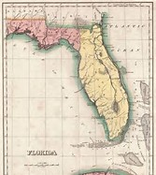
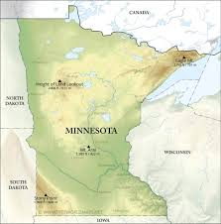
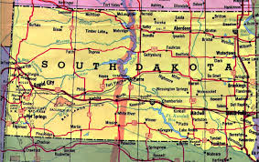
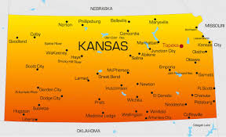
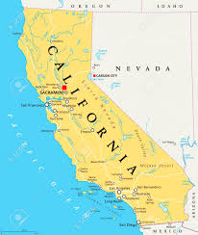
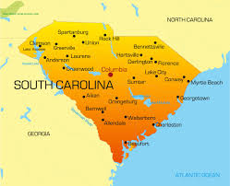
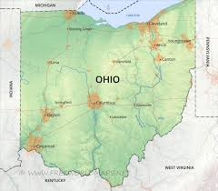
Some of the states where the battle has been (or is being) waged…

Slide 33
Prescriptions written by non-FQHC providers Also known as “eligibility across the continuum of care.”
Resources:
Will be addressed in the various operational sessions here and at Coalition Summer Conference.
Chapter 7 of the NACHC 340B Manual.
December 2018 Office Hours.
Auditors, and Apexus.

Slide 34
340 Shades of Gray (& Counting…)
Question: Can a prescription written by a non-FQHC doctor for a FQHC patient be filled by a health center using 340B inventory?
Answer: It depends.
In some circumstances, the answer is clearly “yes”.
In others, it is clearly “no.”
But there is much gray area in between the two – and it’s getting grayer….

Slide 35
Eligibility Around the Continuum of Care
340B purchased drugs may only be dispensed to fill prescriptions for those patients who meet the HRSA definition, AND that emanate from a health center medical site that is registered on the OPAIS, or a service that is in the health center’s Scope of Project as reflected on Form 5C in the EHB.
Primary Care Medical Home (CE)
Specialty Care Referral
Hospital Discharge
Episodic Acute Care
Notes:
Speak to new patients coming in to the health center who have an established relationship with a specialist – document referral for continuation of care

Slide 36
Supporting and Demonstrating Compliance
Infrastructure
Pharmacy Oversight Committee
Point of Dispensing
Eligibility screens
Closing the Loop
30/45 day audit protocol
Comprehensive policy/procedure
Staff training
RX access to identify individual referrals from eligible health center sites
Care management follow-up
Corrective action

Slide 37
Sliding Fee, Charges, etc.
Resources:
Covered during the Wednesday 11:00 AM CHC Expert Session.
Chapter 4 of the Manual.
The December 2019 Office Hours discussed
how BPHC’s SFS rules apply to pharmacy, and
a model for implementing SFS in contract pharmacies
The February 2019 Office Hours discuss DIR fees.

Slide 38
HRSA Rules re: Charges
The 340B program has no explicit requirements re: how much patients should be charged for 340B Rx.
BPHC’s sliding fee rules:
Do apply to the service cost (aka pdf) – if any -- associated with a drug
Do not apply to the ingredient cost of the drug.
So… if you charge patients an explicit pdf on dispensed drugs:
This pdf is subject to the SFS rules
The pdf should be listed on your official schedule of charges.

Slide 39
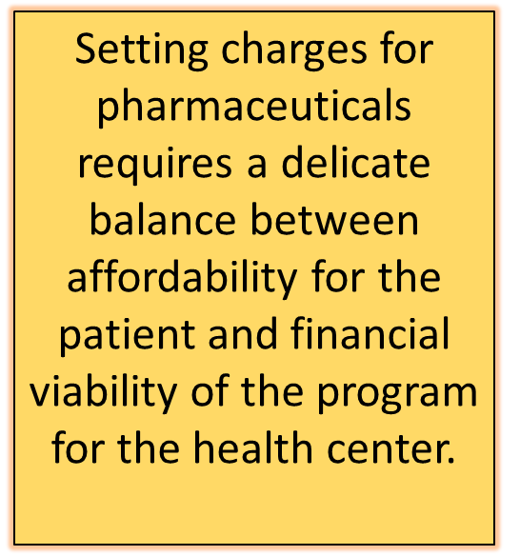
Goals: Affordability and Viability
Beyond these rules, health centers have flexibility to set their Rx charges – provided that these charges do not pose a financial barrier for patients.
While 330 funds and program income can not be used to slide the pdf for persons above 200% FPL, there are no explicit rules for the ingredient cost.

Slide 40
Clinic-Administered Drugs
Resources:
April 2019 and Sept. 2019 Office Hours feature discussions of on-the-ground strategies for purchasing, tracking, and auditing, by Becky Cheek and Sabrina Allen.
Will be addressed in the first session tomorrow AM.
There will be a full 90-minute session on this topic at this year’s 340B Summer Conference in DC.

Slide 41
Optimal Utilization System-wide
Prescriptions dispensed from pharmacy
Clinic administered drugs and devices
Systematic tracking from purchase to patient at the unit/NDC level
Compliance requirement

Slide 42
Clinic-Administered Drugs
Currently a “hot topic” for HRSA auditors.
Not using 340B for clinic-administered drugs is “leaving money on the table.”
But adequate tracking can be complex and cumbersome.
Must track from purchase to patient at the NDC level.
There are ways to achieve 340B savings on clinic-administered drugs, while also ensuring compliance.

Slide 43
Audits & Compliance
Resources:
Discussed in Chapters 13 & 14 of the Manual. The Manual also contains several self-audit tools.
The January 2029 and June 2019 Office Hours discussed
Lessons learned from a 340B audit (thank you Becky Cheek)
Recent trends in audit findings (thank you, Matt Atkins)

Slide 44
Still have questions?
Join us for tomorrow’s
Q&A/ Networking Breakfast for FQHCs
7:15 – 8:30
Sapphire Boardroom
BYOBreakfast from the Exhibit Hall

Slide 45
Additional Questions?
Colleen Meiman
Senior Policy Advisor
National Association of Community Health Centers
Washington, DC
301-906-5958
cmeiman@nachc.org

