Slide 1
“Did You Knows” and Quick Tips to Prevent Heart Attacks and Strokes
Notes:
This "Did You Knows" and Quick Tips slide set distills down the most important information, ideas, and actions to prevent heart attacks and strokes into a format that can be digested quickly and used through a variety of communication channels.
We hope this helps you and your organization offer your busy clinicians and care teams the right information in a format that works for you to achieve your improvement goals. This slide deck complements the document version also called "Did You Knows and Quick Tips to Prevent Heart Attacks and Strokes".
The slides include talking points to make the content easy to deliver. You may use one or a few slides at a time, or mix and match them. – Use them any way you like with other learnings and presentations, etc. We hope you find this resource useful and look forward to any feedback you might have. Please send comments to: nachcmillionhearts@nachc.org
Please click here for the latest version of this PPT. [coming]
Thank you!
The NACHC Million Hearts Team

Slide 2
▼PURPOSE
Assist PCAs and health centers in training care teams on cholesterol management with patients. Provide evidence-based content that can be digested quickly and used for trainings or in email/newsletter communications.
Notes:
Together, heart disease and stroke are among the most widespread and costly health problems facing the nation, accounting for over $316.6 billion in health care expenditures and lost productivity annually (CDC, 2019). Nearly 40% (2 in 5) of adults in the United States have a total cholesterol reading at or above 200 mg/dL. Cholesterol is known as a ‘silent killer’ since many patients do not feel signs or symptoms. Sustaining high cholesterol levels increases the patient's risk for heart disease and stroke which are the two leading causes of death in the United States.
Fortunately, we know today's most effective evidence-based interventions to improve cholesterol management and statin therapy. The challenge is ensuring our clinicians and care teams are doing the most impact things for their patients when managing high cholesterol or patients at high risk for a cardiovascular event. Achieving optimal cholesterol management requires several key strategies to be delivered by clinicians with other care team members. Sometimes, all clinicians and care teams need is more information - but more often, we need to change attitudes and habits to firmly adopt new ways to deliver care. For this reason, these "Did You Knows" and Quick Tips slides include references to the latest research, condensed into important bits of information, supported by relevant tools and resources.
Presenter: this slide set distills the most useful information, ideas, and actions to improve cholesterol management in a format that can be used through a variety of communication channels. We hope this helps you and your organization reach your busy clinicians and care teams with the right information, in the right amount, in a format that works – and ultimately enables your audience to achieve cholesterol management goals!
Sources:
Benjamin EJ, Virani SS, Callaway CW, et al.; American Heart Association Council on Epidemiology and Prevention Statistics Committee and Stroke Statistics Subcommittee. Heart disease and stroke statistics—2018 update: a report from the American Heart Association. Circulation. 2018;137:e67–492.
Tsao CW, Aday AW, Almarzooq ZI, Beaton AZ, Bittencourt MS, Boehme AK, et al. Heart disease and stroke statistics—2022 update: a report from the American Heart Association. Circulation. 2022;145(8):e153–e639.
Yoon PW, Gillespie CD, George MG, Wall HK. Control of hypertension among adults--National Health and Nutrition Examination Survey, United States, 2005-2008. MMWR Suppl. 2012 Jun 15;61(2):19-25.

Slide 3
IMPROVING CHOLESTEROL MANAGEMENT
For Clinicians
Notes:
The first set of slides focuses on improving cholesterol management and is intended for clinician audiences.

Slide 4
Quick Tip
Be prepared for the questions patients may have about statins. Consider sharing one of the resources below through the patient portal in advance of the visit.
How Do Statins Prevent Heart Attacks and Strokes: Patient Education Animation | English | Spanish
The Scoop on Statins | Million Hearts® (hhs.gov)
Common Patient Questions Q&A
Notes:
Getting the right information to patients and debunking misinformation about statins can be a challenge. As a clinician, you are a trusted resource for your patients.
Create a safe space for your patients to raise their concerns or questions – even if they don’t make sense to you. Misinformation around statins and their side effects has made it harder to get patients on board with this potentially life saving medication. Prioritizing a conversation around statins may help your patients understand that statin therapy can prevent a life-altering or -ending cardiovascular event.
The resources on this slide are here to help you prepare for the questions patients may have. The first two resources help inform patients about the importance of taking statins as prescribed. Consider sharing one of them through the patient portal or linked to a text message communication for patients to review before or after a visit. The third resource, Common Patient Questions Q&A, helps provide evidence-based answers to patients’ most frequent questions about statins. Consider reviewing this when you know a patient who is indicated for statins is scheduled for an encounter or keep it handy during relevant visits.

Slide 5
Quick Tip
For your patients at high risk of ASCVD events who are hesitant to start a statin, keep the conversation going. Say, “You sound hesitant to start a statin. I want you to seriously consider it, because it could save your life. If we were to prescribe a statin, this is what it would be....if you have more questions before our next visit, email me (or use the portal)…”
Notes:
Getting a diagnosis of or being told you are at high risk of atherosclerotic cardiovascular disease (ASCVD) can be scary for patients.
From the clinical perspective, it may seem obvious that a statin with lifestyle changes is the straightforward answer. As humans, we can attest that change is hard – especially accepting a new medication that may be needed for life. For high-risk patients who are hesitant to initiate statin therapy, it is important to not give up and keep the conversation going. - Your patients’ health depends on it.

Slide 6
Did you know?
In most cases, statin intolerance is over-estimated and over-diagnosed.
Around 93% of patients on statin therapy can be treated effectively, with very good tolerability.
Prevalence of Statin Intolerance: A Meta-Analysis | European Heart Journal
Statin-Associated Side Effects | NACHC/AMA
Notes:
Statins are one of the most well-studied medications. Side effects from statins can occur but are often grossly overestimated – particularly because of negative media attention in the past. A broad meta-analysis found that 93% of patients on a statin will be able to do so without issue.
The article cited on this slide reviewed 176 studies across the globe to assess the prevalence of and factors that may lead to statin intolerance. Over 4 million patients were represented in the analysis. The study found that the overall prevalence of statin intolerance was 9.1%. Certain factors such as being female, hyperthyroidism, advanced age, or obesity were found to increase the probability of statin intolerance; but most patients did not experience intolerance.
Sometimes, the choice to not initiate a statin or the choice to discontinue a statin is not based in fact. A patient may be worried about side effects or symptoms to statins that are not actually statin-associated. You can help address concerns over satin-associated side effects (SASE) by assessing and documenting any aches or pains before initiating statins, emphasizing the low risk of SASE, and explaining that SASE can typically be addressed/resolved by trying a different statin or lowering the dose. Proactively addressing statin intolerance concerns may help move patients toward choosing to take this potentially life-saving medication.

Slide 7
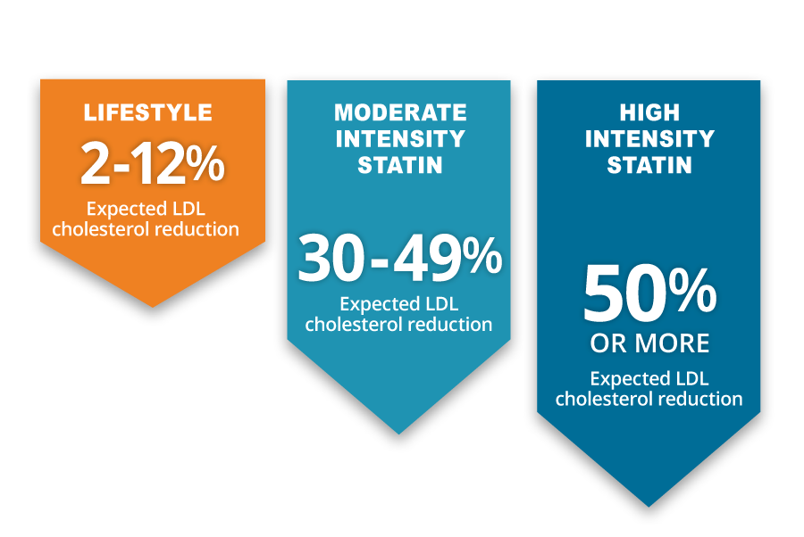
Did you know?
For patients at high-risk of a cardiovascular event, a healthy lifestyle is essential but not enough. Diet alone will typically reduce LDL by less than 10mg/dL in high-risk patient groups and exercise will reduce LDL by less than 5mg/dL. A 30-50% reduction in LDL is recommended for high-risk patients -which requires a high- or moderate-intensity statin.
Statins and Lifestyle: Patient Education Infographic | English | Spanish | nachc.org
Notes:
A healthy diet and regular exercise are essential to improving or maintaining health for all people. But healthy lifestyle changes alone are not enough to lower LDL cholesterol for patients who already have clinical ASCVD or who have very high LDL or diabetes.
Unlike hypertension, where lifestyle and pharmacological treatment are often sequential, this is not the guideline-supported approach for patients at high-risk of a cardiovascular event. Lifestyle changes must be coupled with a statin regimen to achieve an acceptable level of benefit for high-risk patients. Diet alone will typically reduce LDL by less than 10 points and exercise less than 5. Often, with our high-risk patients, we need a 30-50% LDL reduction to reach a safe level. Prescribing lifestyle modification along with a high intensity statin is indicated for most patients at high risk for a cardiovascular event.
The Statin and Lifestyle Patient infographic is offered as a resource in this slide for clinicians or care team members to use with patients to help them visualize the benefits of a statin in their medication regimen. The infographic uses the comparisons on this screen to show patients how a statin plus lifestyle changes can help them reach their LDL cholesterol goals.

Slide 8
Did you know?
A fasting LDL lab result is no longer needed to prescribe a statin. Current guidelines indicate non-fasting labs can be used in statin prescribing for most patients.
Statin Therapy for High-Risk Groups Summary Video (13 min.) | NACHC and AMA
2019 ACC/AHA Guideline on the Primary Prevention of Cardiovascular Disease
Notes:
Old habits are hard to break. One of them is asking a patient to fast before an LDL-lab test, before prescribing a statin. For most patients, non-fasting labs are now acceptable to assess LDL cholesterol. In addition, certain higher-risk patients (those with Clinical ASCVD and diabetes) can be prescribed a statin with no lab test at all.
Same-day labs or even better, point-of-care lipid testing, may remove key barriers to identifying patients with very high-LDL or familial hypercholesterolemia. When a patient has to return for an additional visit just for labs, compounded with the need to fast, this leads to unwanted delays –or worse, patients not returning at all. Take advantage of the latest evidence-based guidance for non-fasting lipid panels to optimize cholesterol management as a life-saving step for your patients.
The short webinar and guidelines linked on this slide provide an overview of the statin prescribing guidance for patients with:
Clinical ASCVD
Diabetes with LDL 70-189
Age 20-75 with LDL ≥190
This training is a tool clinicians can reference over time and is worth sharing with the entire clinical team.

Slide 9
Did you know?
NACHC created a Cholesterol Provider Training Package to help guide clinical decision support for statin prescribing, and for use in clinical meetings or clinician trainings.
NACHC
Cholesterol Provider Training Package
Statin Adherence (downloadable tool to use)
Statin Associated Side Effects (downloadable tool to use)
Statin Therapy for High-Risk Group Summary Video (13 min.)
Statin Guideline Snapshot (downloadable tool to use)
Statin Inertia Chart (downloadable tool to use)
Q&A: Common Patient Questions about Statins
Notes:
It can be hard to keep-up with changing guidelines, care standards, and other nuances of patients care. To help, NACHC created the Cholesterol Provider Training Package with consolidated information, tools, and resources so clinicians can make the best care decision for their patients.
The Cholesterol Training Package includes a series of tools, such as:
Statin Adherence: A tool that outlines the issue of medication nonadherence and the reasons patients may not adhere to medications
Statin Associated Side Effects: Which reviews how to approach patients with potential statin-associated side effects or statin-associated muscle symptoms
Statin Therapy for High-Risk Group Summary Video: A detailed training from NACHC and the AMA about current guidance for statin prescribing with the following risk groups:
Clinical ASCVD
Diabetes with LDL 70-189
Age 20-75 with LDL ≥190
Statin Guideline Snapshot: Reviews statin management in high risk patients and highlights the most important points from the 2018 ACC/AHA Guideline on the Management of Blood Cholesterol
Statin Inertia Chart: A tracking tool to determine if there are potential inertia concerns with statin prescribing
Q&A: Common Patient Questions about Statins: A summary of common patient questions and responses to help clinicians effectively address patient questions during a care encounter

Slide 10
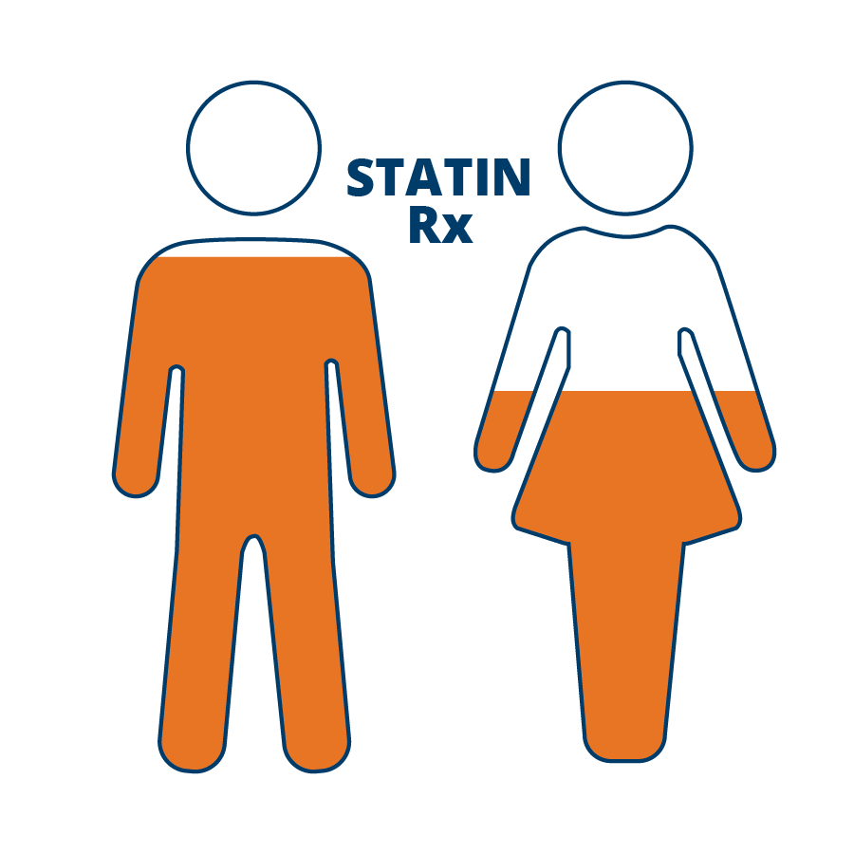
Did you know?
Women are less likely to be prescribed a statin than men – even when they have high-risk factors, such as clinical ASCVD.
Use data-driven approaches to see if your female patients indicated for statin therapy have appropriate prescriptions.
Cardiovascular Risk and Statin Therapy Considerations in Women - PubMed | nih.gov
Gaps and Disparities in Primary Prevention Statin Prescription During Outpatient Care | PubMed (nih.gov)
Notes:
As care providers, we strive to provide the best care for all of our patients. Our intention should be to ensure all patients receive equitable care - but sometimes we fall short. In statin prescribing, data show that women are less likely to be prescribed a statin than men – even when they have high-risk factors, such as clinical ASCVD. When NACHC reviewed our own Million Hearts data, we found that female patients with clinical ASCVD were half as likely to receive a statin prescription than male patients with ASCVD. This prescribing disparity can lead to tragic, avoidable health outcomes for women.
One way to combat cholesterol management disparities is to look at prescribing data for all patients. Assess which groups of high-risk patients are falling behind in statin prescriptions. When you are aware of gaps in care, you can address them. Additional tactics may also include spending more time debunking myths around statin prescribing for women to decrease prescribing inertia.

Slide 11
Did you know?
Familial hypercholesterolemia (FH) is a genetic condition that causes very high LDL that may affect up to 1 in 250 people. Could you have patients with FH who are undiagnosed? Diagnosing and treating FH at an early age prevents early onset cardiovascular disease and increases life expectancy.
International FH Foundation
Notes:
Dislipidemia is commonly known to be caused by poor lifestyle and diet. However, for some patients, it is genetic and unavoidable despite a healthy weight or other markers of a healthy lifestyle. Familial hypercholesterolemia (FH) is an inherited condition affecting about 1 in 250 US adults. It often remains undiagnosed and is a frequent cause of heart attacks in younger adults.(1)
Adults aged 20–39 who have this treatable condition should receive statin therapy. Those who don't have a 100-fold increased risk, approximately, for death compared to those without the condition.(2)
The key to identifying patients who may be hiding in plain sight with FH is to ask about a family history of high cholesterol or early heart attacks, and keep up with cholesterol screening. The International FH Foundation provides important information about FH and is worth a review to learn more.
S.D. de Ferranti, A.M. Rodday, M.M. Mendelson, J.B. Wong, L.K. Leslie, R.C. Sheldrick. Prevalence of familial hypercholesterolemia in the 1999 to 2012: United States National Health and Nutrition Examination Surveys (NHANES). Circulation, 133 (11) (2016), pp. 1067-1072
A. Neil, J. Cooper, J. Betteridge, N. Capps, I. McDowell, P. Durrington, et al. Reductions in all-cause, cancer, and coronary mortality in statin-treated patients with heterozygous familial hypercholesterolaemia: a prospective registry study. Eur Heart J, 29 (21) (2008), pp. 2625-2633

Slide 12
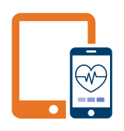
Quick Tip
Use technology to increase cholesterol screening and appropriate statin prescribing at your practice. Telehealth appointments and point-of-care lipid machines can help.
Managing Cholesterol Using Technology – Live Q&A with Winding Waters and Zufall Health Centers (45 min. video) | NACHC
Notes:
Technology can be a valuable tool to make the most of the patient visit – particularly to increase cholesterol screening and ensure appropriate statin prescribing at your practice. When time is limited during a face-to-face encounter, telehealth can be an excellent tool to discuss and prescribe statin therapy or follow up on a recent statin prescription. Point-of-care lipid machines can accelerate obtaining a patient’s LDL cholesterol level by enabling related clinical care decisions during the patient visit. This technology can reduce delays and barriers in statin prescribing for patients who don’t have a current LDL or can't easily return for a follow-up visit.
Winding Waters and Zufall health centers have successfully integrated point-of-care lipid machines and telehealth into their practice workflows. This slide offers a link to a Million Hearts Learning Lab recording where these health centers described how they integrated these workflows into their practice.

Slide 13
IMPROVING CHOLESTEROL MANAGEMENT
For Care Teams
Notes:
This second set of slides focuses on improving cholesterol management and is intended for care teams.

Slide 14
Quick Tip
Initiating a statin with a patient may take more than one conversation. Patients may need support to debunk misinformation or have questions about why they may need a specific medication. Read your patient’s non-verbal cues about their uncertainty or how they may feel about starting a statin.
Q&A with Dr. Cynthia Jones of Mosaic Health (NY) – Short videos with insight on how to address patient questions and initiate statin use.
Why Statin and Lifestyle are Important
Ways to Begin the Conversation
Statins and Healthy Lifestyle to Lower Cholesterol in High-Risk Patients video series highlighting the stories of Laurie and Millie, who share their experience and the benefits they achieved after starting statin therapy.
How Do Statins Prevent Heart Attacks and Strokes: Patient Education Animation (2 min. video) English | Spanish
How Do Statins Prevent Heart Attacks and Strokes: Patient Education Infographic | English | Spanish
Notes:
Initiating statin therapy with a patient is not usually a simple conversation at a single visit. While the clinical guidelines are clear that people at high risk of a cardiovascular event, including those with clinical ASCVD, LDL-C ≥190 mg/dL, and those with diabetes, should be prescribed a statin in most situations, there are a number of reasons why multiple conversations are often needed – and that’s after care teams have worked through our own decision-making process. We weigh the patient’s risk of negative health outcomes if they aren’t prescribed a statin vs. prescribing them a medication you know may be a lifelong treatment with the associated costs and logistics.
On the patient side, it’s hard to feel a need for treatment when you can’t feel symptoms. They may already be prescribed other medications and may have concerns stemming from misinformation or costs. Even when the path of least resistance is to have no conversation about statin initiation, we most likely have at least one conversation about this. If there is push back, we may document patient refusal and leave it alone. The hard right thing is to continue the conversation – and prepare for it to take a number of conversations to move your patient toward readiness to begin a life-saving statin.
The full care team can be instrumental in continuing the statin conversation, and this slide lists a number of resources that can help.

Slide 15
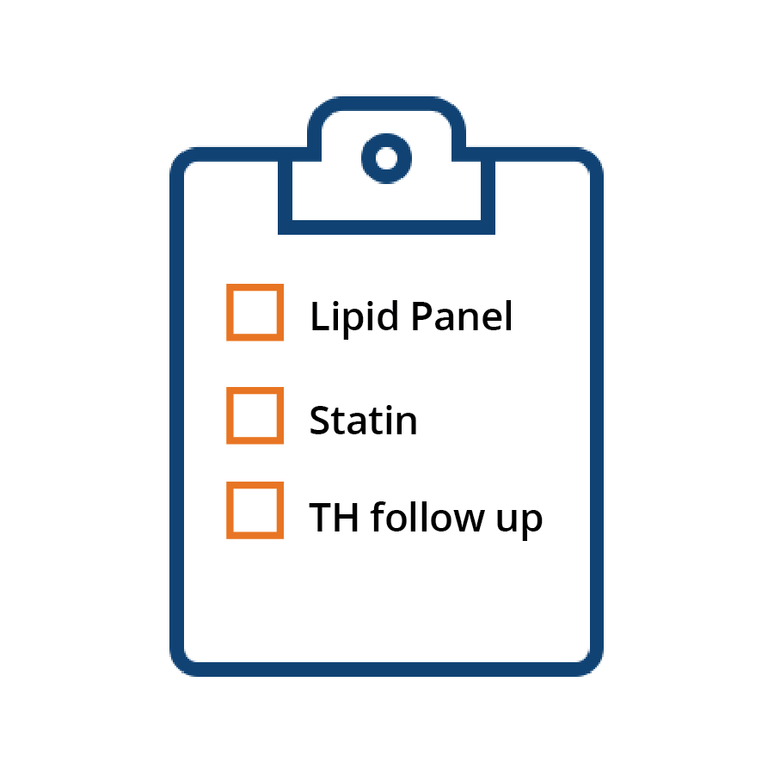
Quick Tip
To ensure cholesterol management is addressed during a 15-minute appointment, discuss whether a lipid panel or a statin is recommended prior to the appointment in the daily huddle. If it still can’t be addressed during the in-person encounter, make it part of your protocol to schedule a telehealth follow-up with the patient.
Notes:
When a patient shows up for a 15-minute appointment, they are usually there for something acute like back pain or a respiratory infection, etc. Care teams work hard to maximize this time through pre-visit planning, and aiming to address as many care gaps as possible – like immunizations, preventive screenings, and ensuring any needed medication refills are put in. If we have time to discuss chronic conditions, we may prioritize behavioral health issues and perhaps hypertension or diabetes.
However, heart disease is still the #1 preventable cause of death. In addition to high blood pressure, high cholesterol is major modifiable risk factor. According the National Ambulatory Medical Care Survey(¹⁾, a cholesterol test is ordered or provided at only 6.9% of office-based physician visits. Our own Million Hearts data indicated that close to half of adults had not had their cholesterol screened in the past 5 years. In terms of statin therapy, national data show that 54.5% (47 million) of people who would benefit from a statin are currently taking one (2). OR put another way, about 45% or over 40 million people indicated for a statin to reduce their risk are NOT on one. We can make real improvements in these statistics by prioritizing cholesterol management.
Use strategies like the daily huddle to discuss in advance whether a lipid panel or statin is recommended prior to a patient’s appointment. If cholesterol management still can’t be addressed during the in-person encounter, make it a part of your protocol to schedule a telehealth follow-up with the patient.
Santo L, Kang K. National Ambulatory Medical Care Survey: 2019 National Summary Tables. Available from: DOI: https://dx.doi.org/10.15620/cdc:123251.
Wall HK, Ritchey MD, Gillespie C, Omura JD, Jamal A, George MG. Vital Signs: prevalence of key cardiovascular disease risk factors for Million Hearts 2022—United States, 2011–2016. Morbidity and Mortality Weekly Report. 2018;67(35):983–991.

Slide 16
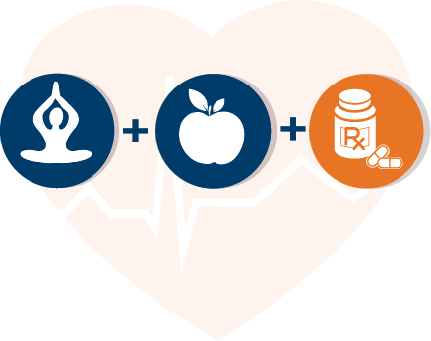
Did you know?
Lifestyle changes alone will not reduce LDL enough in high-risk patient groups. Help your patients understand the importance of regularly using a statin to lower their risk of heart attack and stroke. Aim to increase acceptance of statins and statin adherence.
Statins and Lifestyle: Patient Education Infographic | English | Spanish
How Do Statins Prevent Heart Attacks and Strokes: Patient Education Animation (2 min. video) English | Spanish
Notes:
A healthy diet and regular exercise are essential to improving or maintaining health for all people. But healthy lifestyle changes alone are not enough to lower LDL Cholesterol for patients who are high-risk for a heart attack or stroke, like those with diabetes or very high LDL Cholesterol.
In managing hypertension, we often begin with lifestyle recommendations and then move to medication when lifestyle changes are not enough to lower blood pressure. Unlike hypertension, prescribing statin therapy for high-risk groups is not approached sequentially. The 2018 Cholesterol Guideline recommends that lifestyle changes together with a statin regimen leads to higher levels of benefit for high-risk patients. Sometimes patients may ask to try lifestyle changes first before starting a statin. However, if they are high-risk for a cardiovascular event, the right care is to recommend both. Waiting to prescribe a statin may keep your patient at high risk for heart attack or stroke.
The Statin and Lifestyle Patient infographic listed in this slide is a tool clinicians or care team members can use to visualize the benefits of a statin in the patients’ medication regimen. The infographic uses comparisons to show patients how a statin plus lifestyle changes can help them reach their LDL cholesterol goals. The patient education animation is a great resource to explain statins in a low-literacy, culturally competent way.

Slide 17
Did you know?
For patients at high-risk for a cardiovascular event, having ongoing conversations on statins over their lifetime is important to ensure they continue with their medication. Patients may get discouraged or want to try lifestyle changes alone. Sharing resources, tools and information about statin therapy will provide them with the information they need for adherence.
Mayo Clinic Statin Choice Decision Aid
Statins and Lifestyle: Patient Education Infographic | English | Spanish
The Scoop on Statins: What Do You Need to Know? | hhs.gov
Notes:
Beginning or continuing a medication when you can’t feel it working on your body can be really hard. Plus, if a patient doesn’t fully understand their cardiovascular risk or that high LDL cholesterol can lead to a heart attack or stroke, they may not see the value of a statin.
The Mayo Clinic Statin Choice Decision Aid is a very visual and simple tool to use with patients to illustrate their risk of a cardiovascular event and how statins can reduce that risk. Statins and Lifestyle and The Scoop on Statins, also offered in this slide, are great education tools to use with patients to help them understand why it's important to choose and regularly take their statin medication.
Continuing to check in with patients who are prescribed a statin is also important. Check on barriers to adherence, beginning with health literacy. Address any other social drivers of health that may prevent a patient from taking medication as prescribed.

Slide 18
Did you know?
Nudging clinicians significantly increases statin prescribing during primary care visits; adding a patient nudge amplifies the clinician nudge.
Effect of Nudges to Clinicians, Patients, or Both to Increase Statin Prescribing: A Cluster Randomized Clinical Trial | Cardiology | JAMA Cardiology | JAMA Network
Notes:
Recent research found clinical decision support and peer feedback to clinicians can make a huge difference in ensuring patients who would benefit from a statin receive one!
In randomized clinical trial of 4,131 patients from 28 primary care practices, nudges to clinicians using EHR active choice prompts and monthly peer comparison feedback significantly increased statin prescribing by 5.5 percentage points relative to usual care. Only nudging patients with text messages about the importance of statins before the visit, did not significantly increase statin prescribing, but the combination of nudges to clinicians and patients significantly increased statin prescribing by 7.2 percentage points relative to usual care.
This means adding a patient prompt amplifies a clinician nudge – and reminding both the provider and patient together is the most effective strategy. How can you, in your role as a care team member, help set up these impactful interventions? How might a care team member nudge amplify the effects on clinician and patient behavior even more?

